Slide 1
Title:
Restaurant Website Project

Slide 2
Introduction
restaurant website and online menu: "La pasta bella" wants a website showcasting its ambiance with a gallery, an interactive menu (using tables or cards with filters for Veg/Non-Veg), and an online table reservation form with date/time picker.

Slide 3
Objectives
• Provide online presence.
• Display menu attractively.
• Allow table booking.
• Improve customer experience.

Slide 4
Technologies Used
HTML (HyperText Markup Language) Used to design and structure all web pages of the website.

Slide 5
Website Features
• Home Page (Hero Section)
• About Section
• Image Gallery
• Menu with Filters
• Customer Reviews
• Reservation Form

Slide 6
Menu Highlights
• Veg & Non-Veg Options
• Pasta & Pizza
• Starters
• Desserts & Drinks

Slide 7
User Interaction
• Menu filtering (Veg/Non-Veg)
• Smooth scrolling
• Form input for reservation

Slide 8
Design Elements
• Background images
• Grid layout
• Hover effects
• Clean UI

Slide 9
Advantages
• Easy to use
• Attractive design
• Mobile friendly
• Enhances business reach

Slide 10
Future Improvements
• Online payment integration
• Live order tracking
• Login system
• Admin dashboard

Slide 11
Conclusion
The La Pasta Bella website provides a modern and user-friendly experience with an interactive menu, gallery, and online reservation system, improving customer convenience and strengthening the restaurant’s online presence.

Slide 12
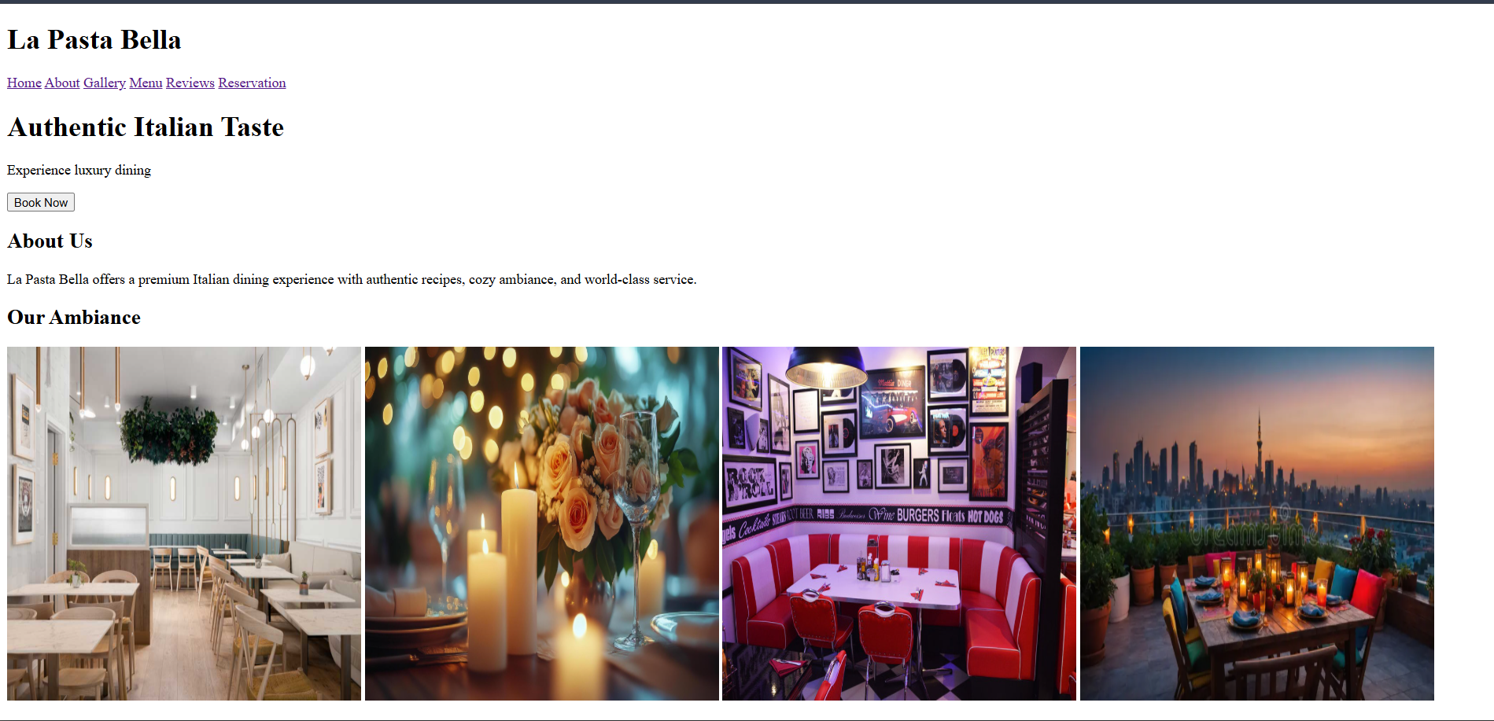

Slide 13
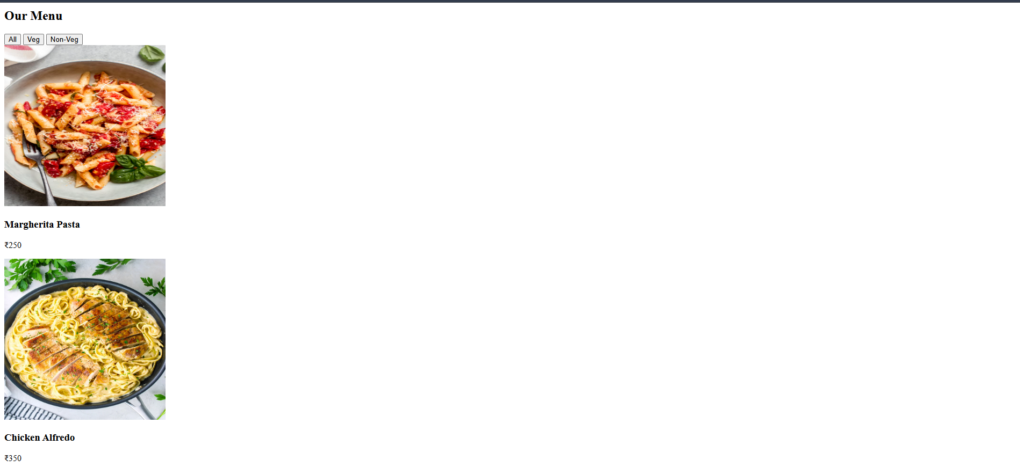

Slide 14
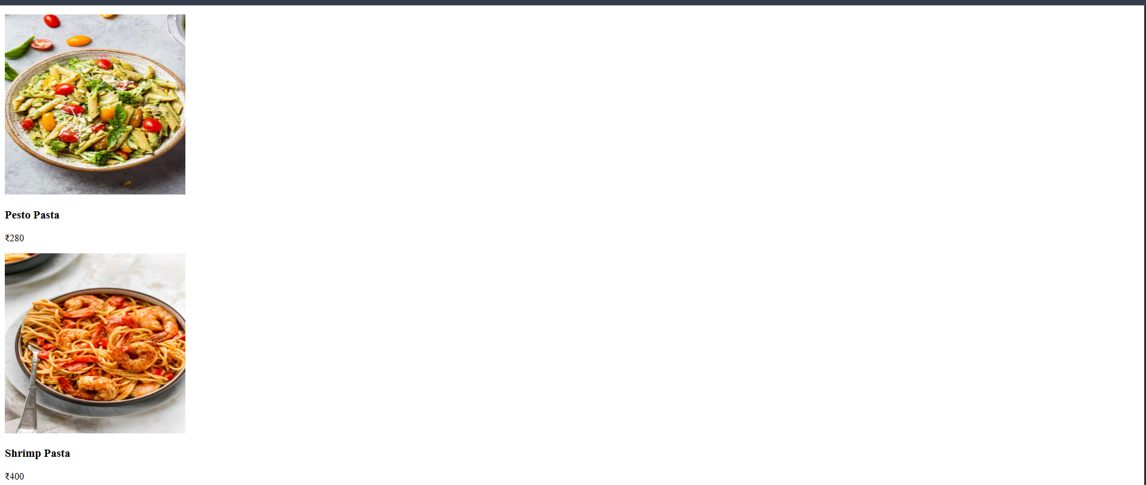

Slide 15
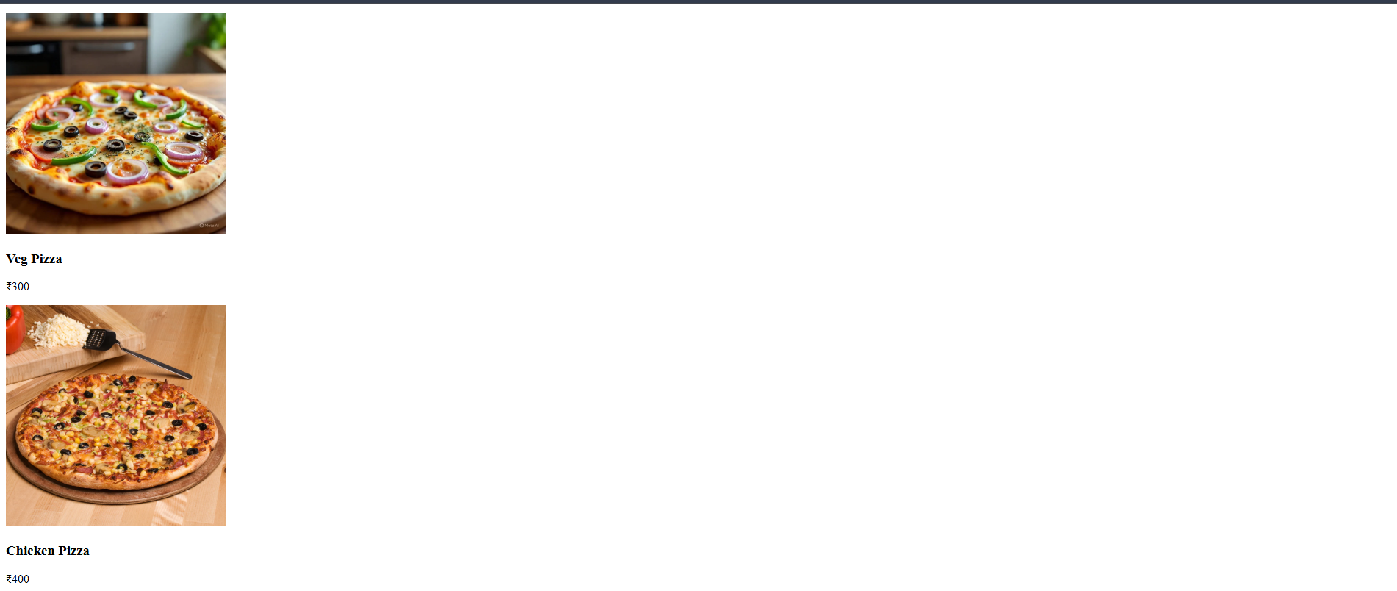

Slide 16
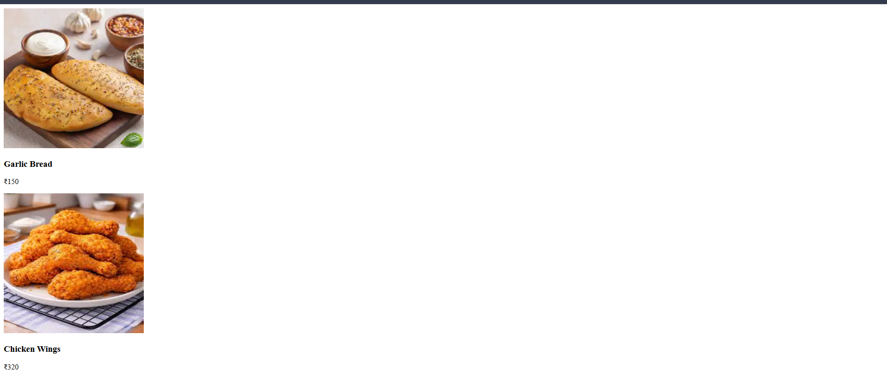

Slide 17
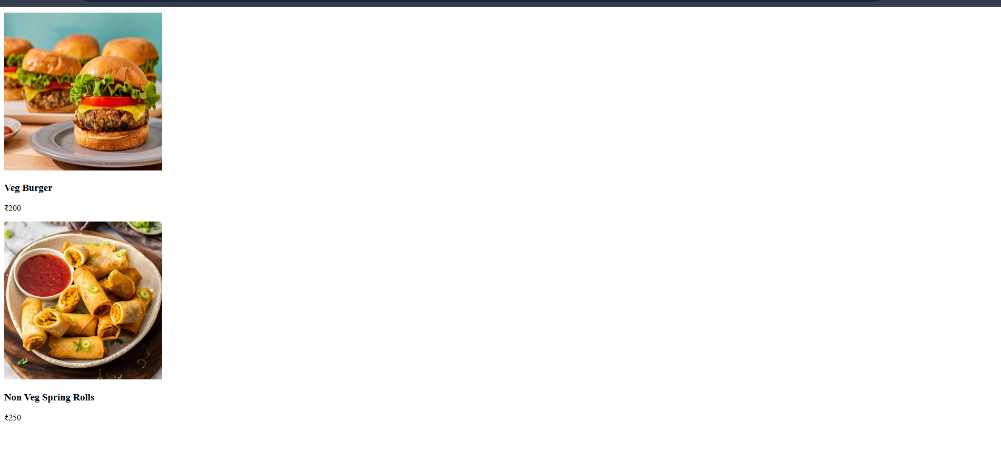

Slide 18
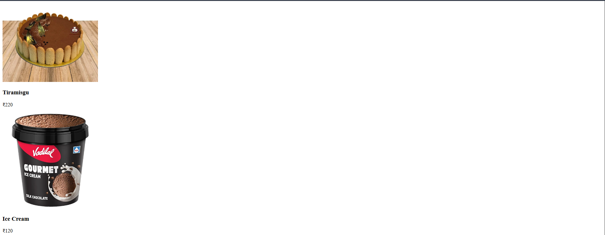

Slide 19
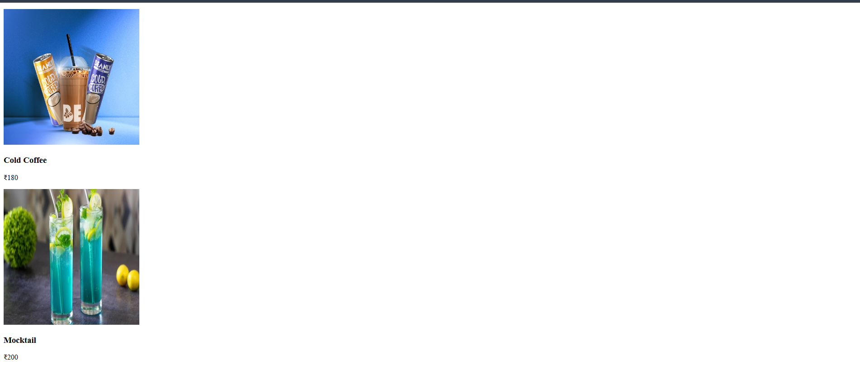

Slide 20
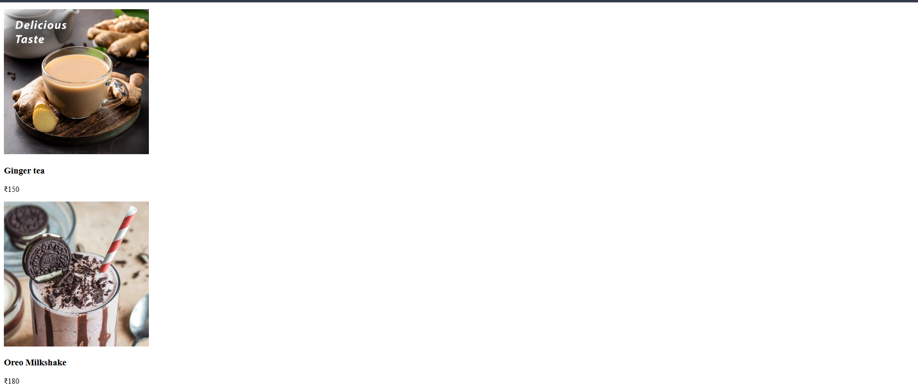

Slide 21
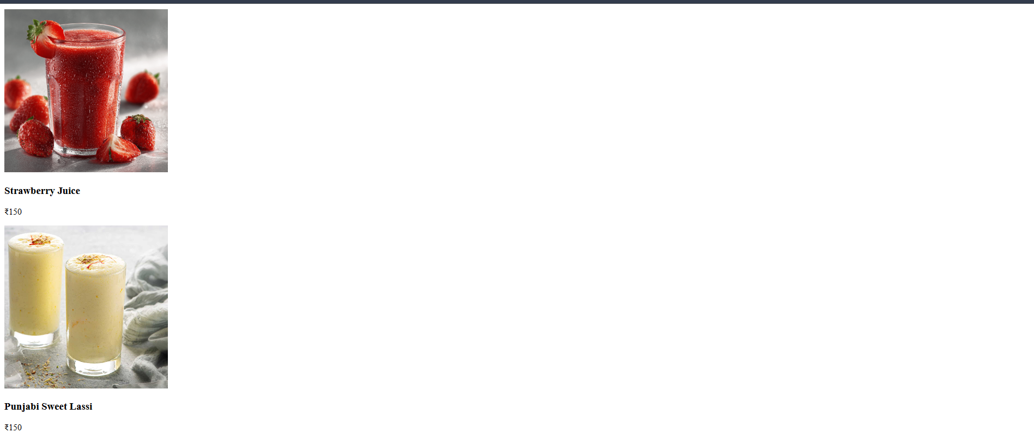

Slide 22
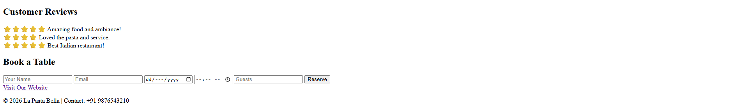

Slide 23
Thank you 😎🙏
Name : Aditi .s. Nakade
USN : CS25008

